Slide 1

Computer Graphics and Image Processing
Course Introduction

Slide 2
Compsci 373 Syllabus
This course introduces the fundamentals of computer graphics and image processing, which are necessary for the analysis and processing of image data and for the reconstruction, modelling, animation, and photo-realistic rendering of 3D.
You will learn:
Basic geometry used in image analysis and scene formation, including transformations, viewing and projection, and digital geometry. (Weeks 1-2)
Key computer graphics concepts including primitives, lighting and shading, texture mapping, ray tracing, and curve and surface representation. (Weeks 2-8)
Image processing fundamentals such as image definition and representation, perception and colour models, grey level and colour enhancement, neighborhood operations and filtering. (Weeks 9-12)

Slide 3
Lecturers
Dr. Alex Shaw (Weeks 1-4)
l.shaw@auckland.ac.nz
Office: 303-528
Office hours: Open door policy or arrange meeting by email.
Dr. Burkhard Wuensche (Weeks 5-8)
burkhard@cs.auckland.ac.nz
Office: 303-529
Office hours: Open door policy or arrange meeting by email.
Dr. Martin Urschler (Weeks 9-12)
martin.urschler@auckland.ac.nz
Office: 303-421
Office hours: Open door policy or arrange meeting by email.

Slide 4
Tutors
Marylyn Alex (Week 3-8)
Mitchell Rogers (Week 1-2 and 9-12)
Check canvas for contact details/office hours

Slide 5
Assessments
25% Coderunner Weekly Assignments
Coding quiz
Theory quiz
Unmarked practice quizzes and sandboxes
20% Mid-semester Test
55% Exam
Optional standalone assignments

Slide 6
Assessments
Students must obtain a pass in both practical(assignments) and theory (test + exam) to pass the course
Practical (25%)
Weekly Coderunner assignments
Theory (75%)
Test (20%)
Exam (55%)
All MCQs
Dates TBA

Slide 7
Missed Work
If you miss the deadline for an assignment and have a valid reason, you should email the lecturer/course coordinator ASAP
If you miss the test/exam for any valid reason, or you sit the test/exam but believe that your performance was impaired for some reason, then you can apply for an aegrotat, compassionate, or special pass consideration
See: University of Auckland Aegrotat and Compassionate Consideration

Slide 8
Mid Semester Test
Date: TBA (around week 7)
Coderunner based
Held in computer labs in evening
Mix of theory and programming questions

Slide 9
Weekly Assignments
All weekly assignments will be using CodeRunner
https://coderunner2.auckland.ac.nz/
Type your solutions directly in browser
Unlimited attempts

Slide 10
Piazza forum
We will be using Piazza as a discussion forum
You will receive an email with an activation link
Feel free to answer each other’s questions

Slide 11
Class reps
We need to elect 1-2 class representatives
You attend 2 staff/student meetings (free food!)
Find out more about how the department runs!
Represent your classmates!

Slide 12
Policy on Cheating and Plagiarism
We use many ways to check that the work students submit for marking is their own and was not produced by, or copied from, someone else.
Note:
All assignments deemed to be too similar automatically receive 0 marks
All students who submitted these assignments are entered into the duplicate assignment register. This list is maintained over your entire time at the university.
Students who have been caught cheating will be notified by email.
Offenders may be referred to the University Disciplinary Committee
Both the person who copied the work and the person whose work was copied are allocated a 0 mark
It is important that you do not share your code with others. Never give anyone a copy of your code. It is the responsibility of each student to ensure that others do not copy their work.
Read: http://www.auckland.ac.nz/uoa/home/about/teaching-learning/honesty

Slide 13
Miscellaneous
We have 3 lectures per week. You need to keep up with the pace
Each lecture will require you to know and understand the content of previous lectures
You must do any exercises provided with the lecture notes to make sure you really understand the content
Tutorials are a great way to supplement lectures
You will need to read supplementary material not included in the lecture slides
Outside of office hours and tutorials, tutors are not supposed to be at hand

Slide 14
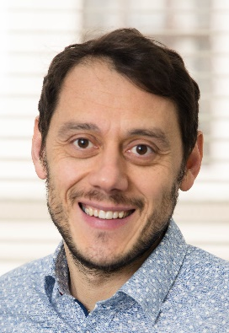
Computer Graphics and Image Processing
Outlook to Image Processing (Weeks 9-12)

Slide 15

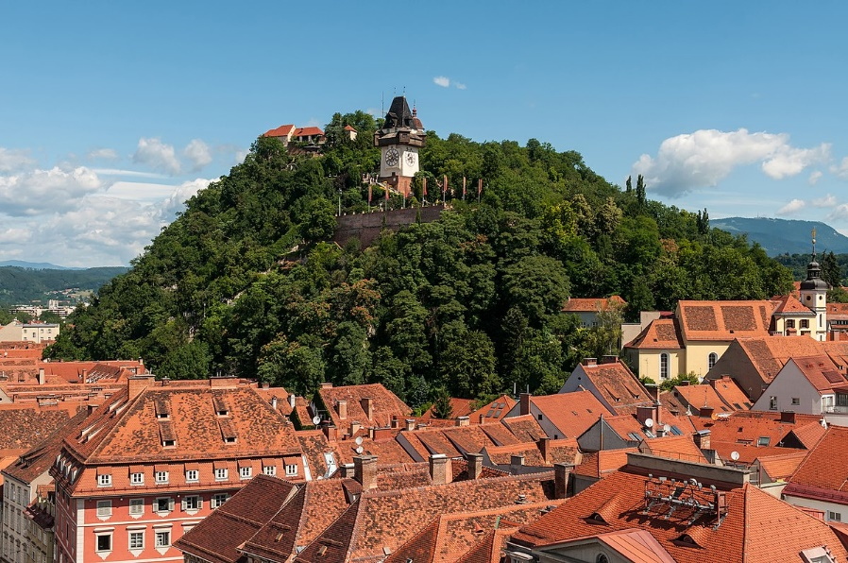
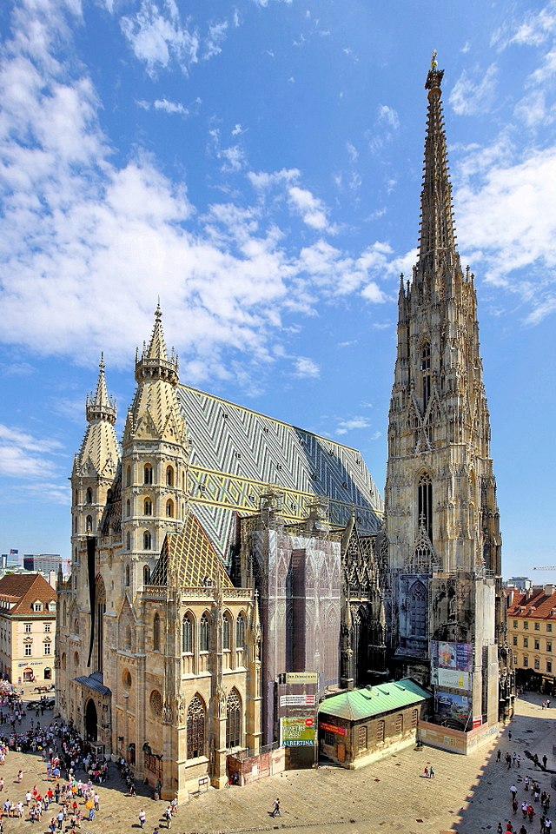
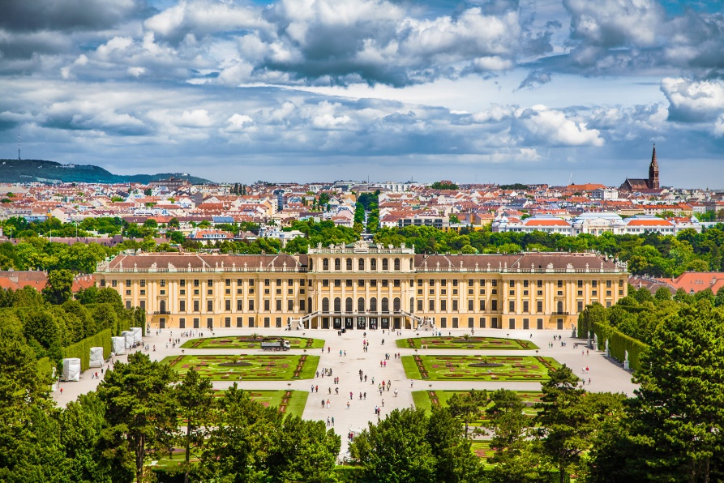
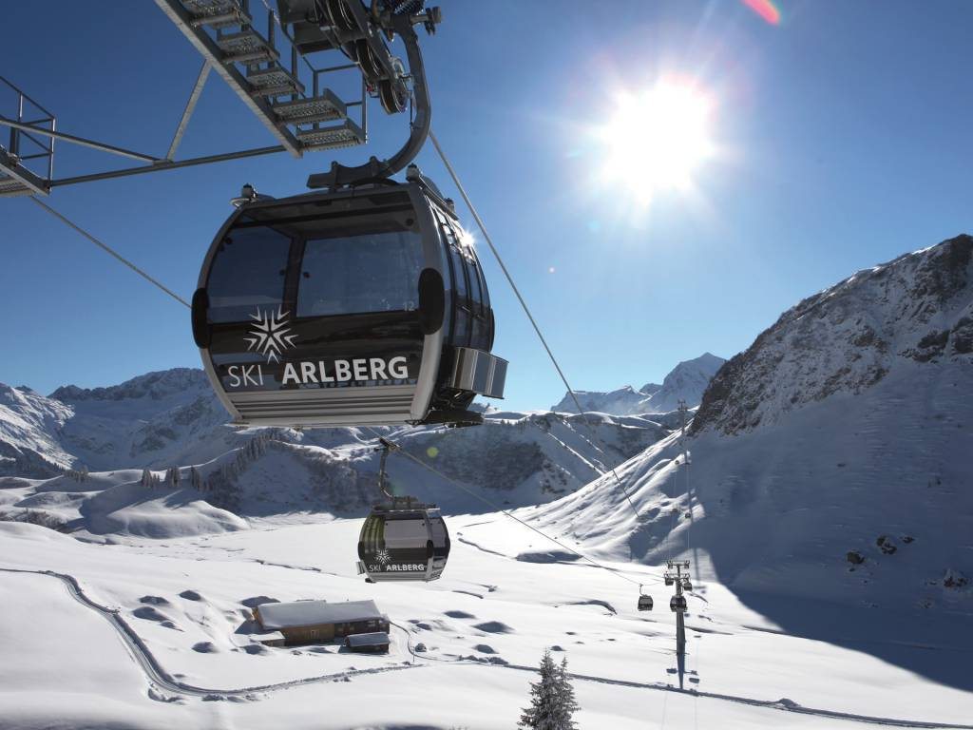
Q: Where am I from?

Slide 16

Q: Where am I from?
Schlossberg, Graz
Hallstatt, Salzkammergut
Schoenbrunn Palace, Vienna
Stephansdom, Vienna

Slide 17
Computer Vision?

Slide 18
Computer Vision
Clocktower, p=90%
Mountain
Village
Some points of interest characteristic for Stephansdom
Historic Roofs
Water
Sky
A palace from Habsburg dynasty in front of an internationally well known city on a cloudy day.
Ski Lift, p=80%
Apres Ski, p=99%

Slide 19
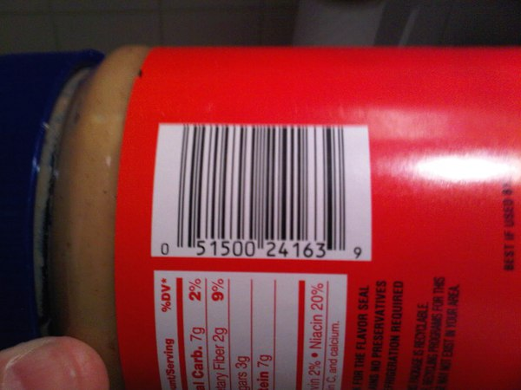
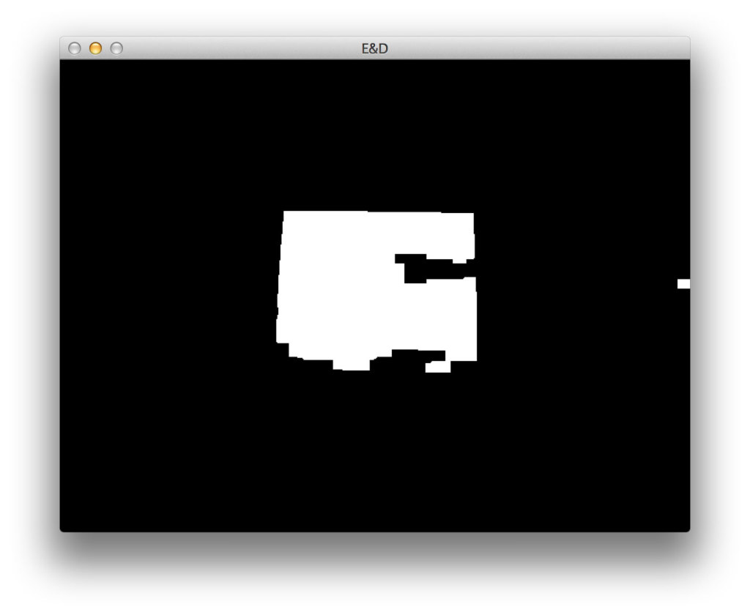
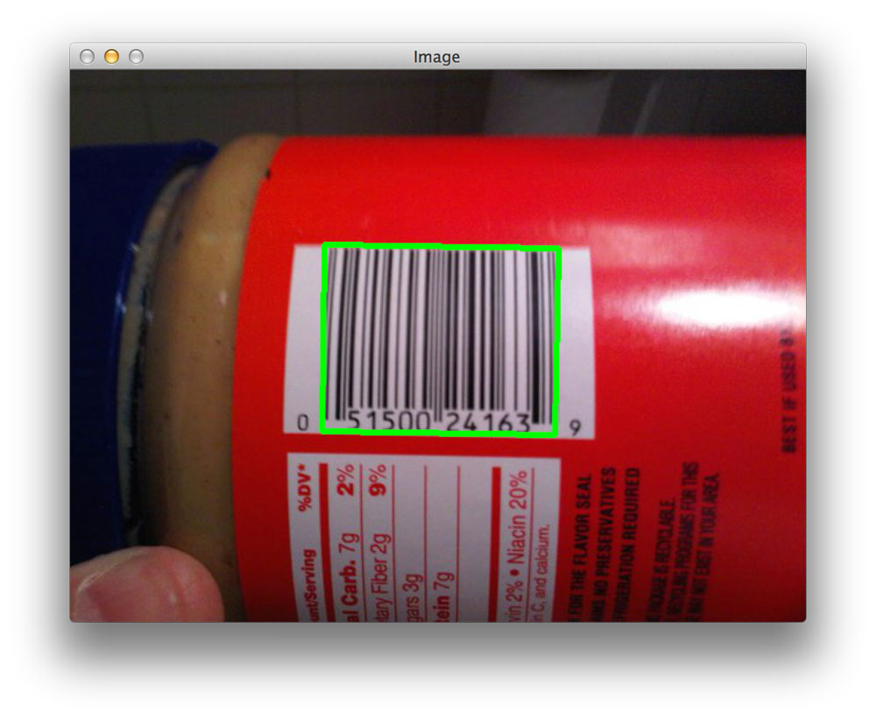
Computer Vision & Image Processing
Teaching machines to “see” and “reason” on what they see
Later this semester: Theory and practice of image processing
CS 373 2020 Assignment: Barcode Detection

Slide 20
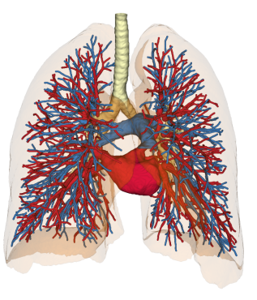
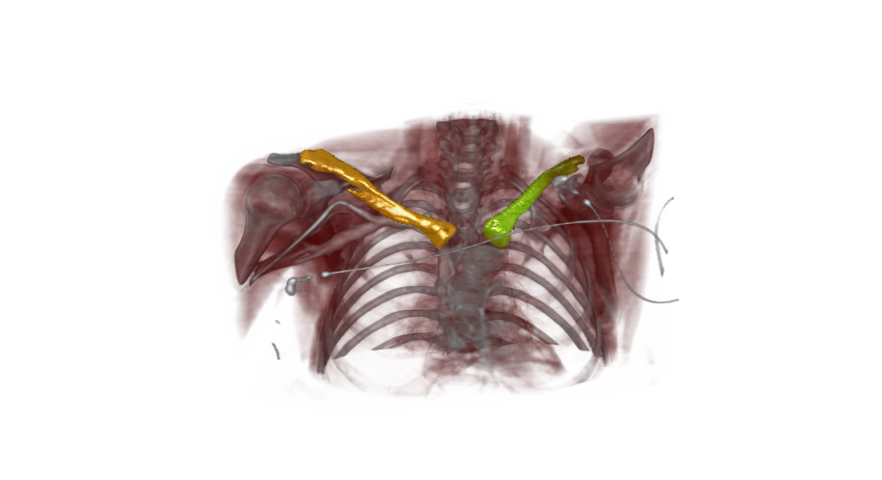
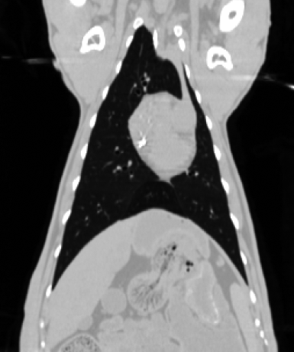
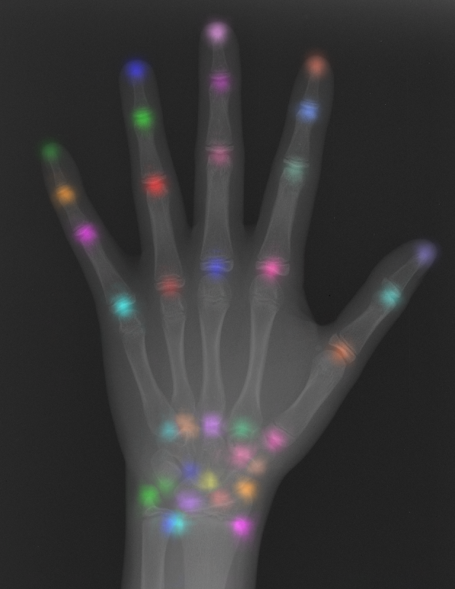
Computer Vision & Image Processing
Later in your journey: Theory and practice of computer vision, medical image analysis (CS773)
Landmark Localization
Artery/Vein Separation
Interactive 3D Segmentation
Deformable Registration

Slide 21
Computer Graphics and Image Processing
Introduction to Computer Graphics
(Weeks 1-8)

Slide 22
What is Computer Graphics?
Computer graphics (CG) is the field of visual computing, where one utilizes computers both to generate visual images synthetically and to integrate or alter visual and spatial information sampled from the real world.
[http://en.wikipedia.org/wiki/Computer_graphics]
OUTPUT
 | descriptions | images
descriptions |  | Computer Graphics
images | Computer Vision | Image Processing
INPUT

Slide 23
What is Computer Graphics?
The art of making the computer draw a picture
Sometimes making the computer draw a lot of pictures very quickly.
We also are interested in the representation and management of the data used to generate these pictures.

Slide 24
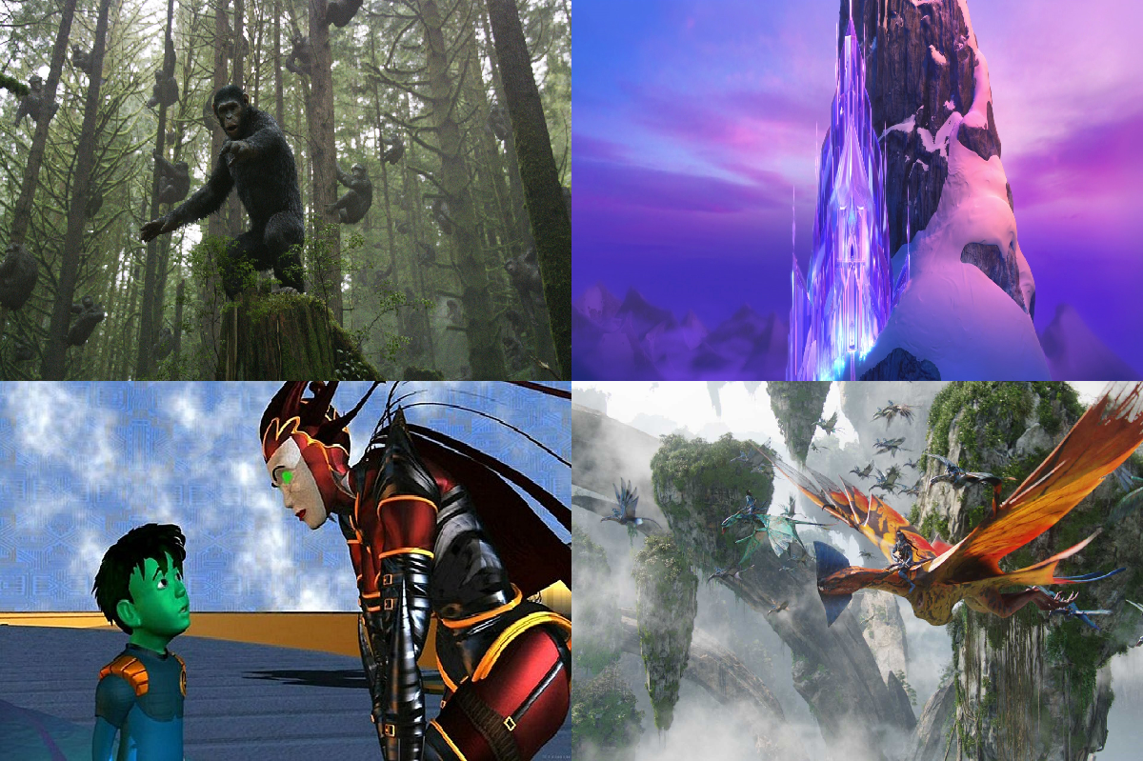
Applications: Movies/TV

Slide 25
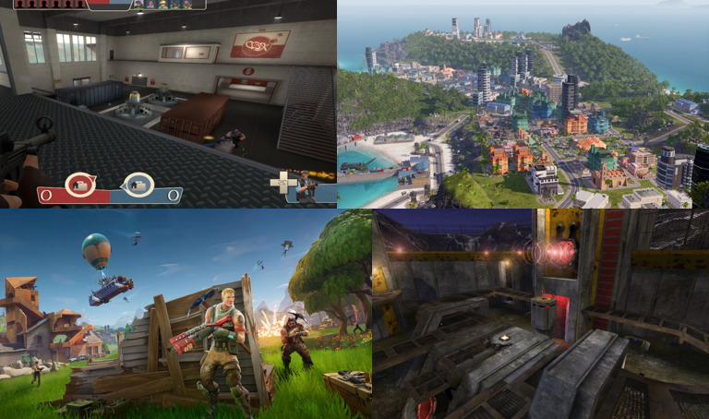
Applications: Video Games

Slide 26
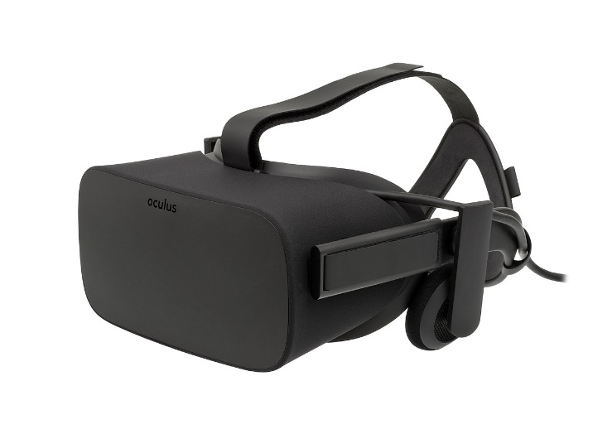
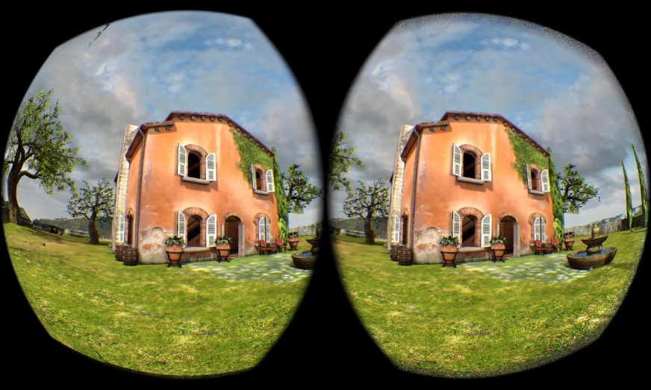
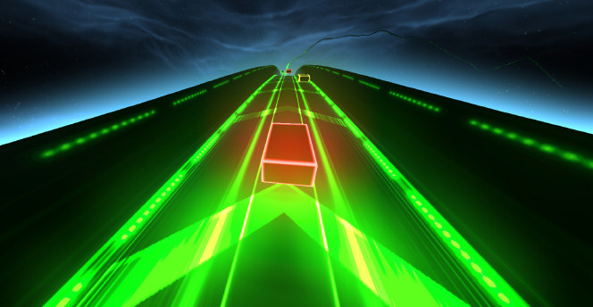
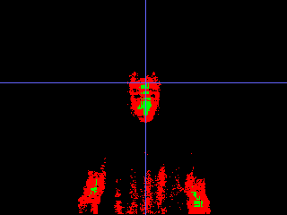
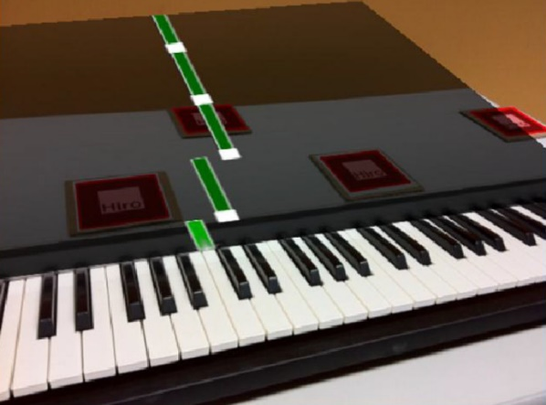
Applications: VR & AR

Slide 27
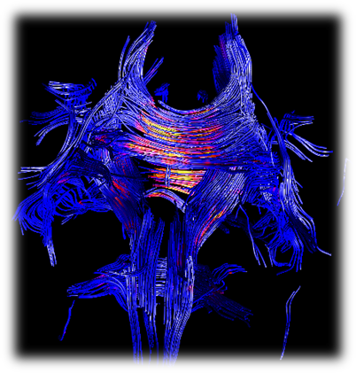
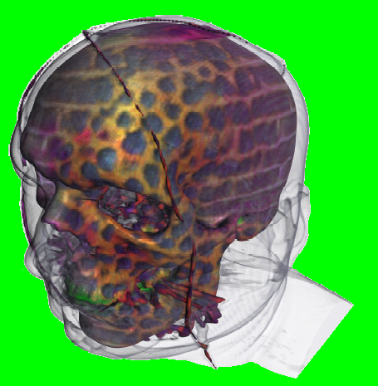
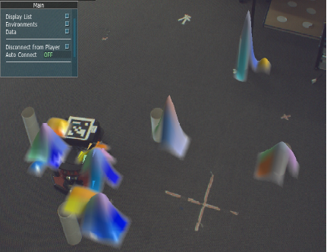
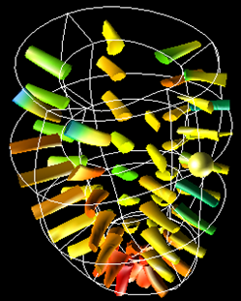
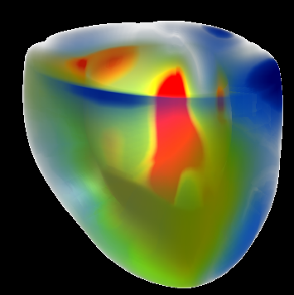
Applications: Visualization

Slide 28
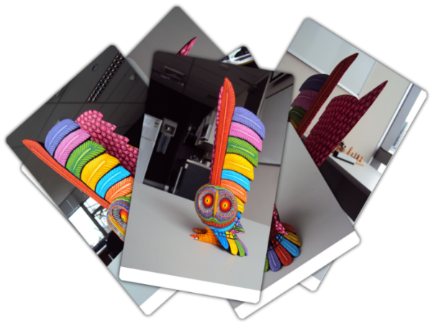
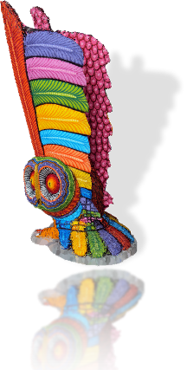

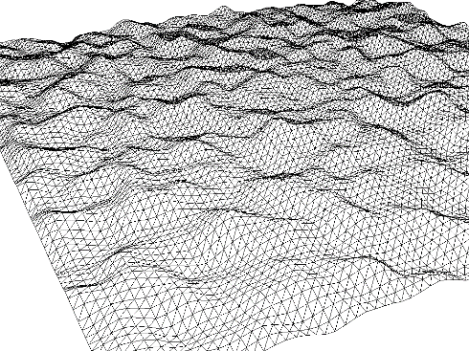


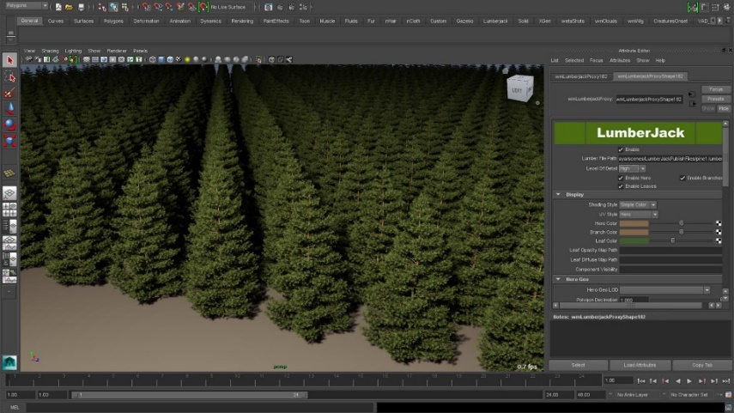
Applications: 3D Content Creation

Slide 29
My Research Areas
VR & AR
Motor learning, education, cognitive screening, motion tracked VR
Games and game technology
Serious games for health and education
3D Content Creation
Procedural content generation, simulation, artist tools
If you’re interested in a postgraduate project in any of these areas, come talk to me.

